Slide 1
Artificial Intelligence DSE 3252 Reinforcement Learning -2
Rohini R Rao Dept of Data Science & Computer Applications
January 2023

Slide 2
Monte Carlo Methods
The term “Monte Carlo” is used for any estimation method whose operation involves a significant random component.
In Reinforcement Learning it is used for methods based on averaging complete returns
Does not require complete knowledge of the environment
Does not require prior knowledge of the environment’s dynamics
Although a model is required, the model need only generate sample transitions, not the complete probability distributions of all possible transitions that is required for dynamic programming (DP)
Monte Carlo methods require only experience
Sample sequences of states, actions, and rewards from actual or simulated interaction with an environment.
Learning from actual experience, yet can still attain optimal behavior.

Slide 3
Monte Carlo Prediction
Monte Carlo methods can thus be incremental in an episode-by-episode sense, but not in a step-by-step (online) sense
Episodic Tasks :
To ensure that well-defined returns are available, we assume experience is divided into episodes
all episodes eventually terminate no matter what actions are selected
Only on the completion of an episode are value estimates and policies changed
MC Methods
suppose we wish to estimate v _{Π} (s), the value of a state s under policy Π,
given a set of episodes obtained by following Πand passing through state s.
Each occurrence of state s in an episode is called a visit to state s.
States may be visited multiple times in the same episode
The first time it is visited in an episode is called the first visit to state s.
Types of MC methods are
First-visit MC method estimates v _{Π} (s), as the average of the returns following first visits to s
Every-visit MC method averages the returns following all visits to s.

Slide 4
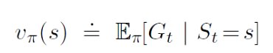
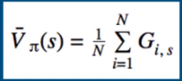
Monte Carlo Policy Evaluation
Return is the total discounted reward:
Trajectory in episode is
S1, A1, R2, ….Sk ~
The value function is the expected return
Estimate any expected value simply by adding up samples and dividing by the total number of samples
i – Episode index
s – Index of state

Slide 5
First Visit Monte Carlo
Average returns only for the first time s is visited in an episode
Initialize the policy, state-value function
Start by generating an episode according to the current policy
Keep track of the states encountered through that episode
Select a state in 2.1
Add to a list the return received after first occurrence of this state
Average over all returns
Set the value of the state as that computed average
Repeat step 3
Repeat 2-4 until satisfied

Slide 7
Every visit Monte Carlo
Initialize the policy, state-value function
Start by generating an episode according to the current policy
Keep track of the states encountered through that episode
Select a state in 2.1
Add to a list the return received after every occurrence of this state.
Average over all returns
Set the value of the state as that computed average
Repeat step 3
Repeat 2-4 until satisfied

Slide 8
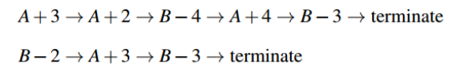
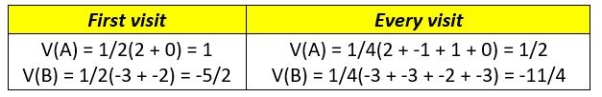
Computation of Return

Slide 9
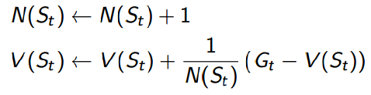
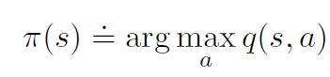
Incremental Mean & Policy Improvement
We update v(s) incrementally after episodes. For each state St, with return Gt:
In non-stationary problems, it can be useful to track a running mean, i.e., forget old episodes:
V(S_{t}) ← V(S_{t}) + α (G_{t} − V(S_{t}))
Policy improvement is done by making the policy greedy with respect to the current value function.

Slide 10
Monte Carlo Estimation of Action Values
Dynamic Programming (With a model)
state values alone are sufficient to determine a policy;
looks ahead one step and chooses whichever action leads to the best combination of reward and next state
Monte Carlo Methods (Without a model)
however, state values alone are not sufficient
One must explicitly estimate the value of each action in order for the values to be useful in suggesting a policy.
Thus, primary goal for Monte Carlo methods is to estimate q*.
To achieve consider the policy evaluation problem for action values.

Slide 11
Policy Evaluation Phase
The policy evaluation problem for action values
is to estimate q _{Π}(s, a), the expected return when starting in state s, taking action a, following policy Π.
Issues include
Many state–action pairs may never be visited.
If Π is a deterministic policy, then in following Π one will observe returns only for one of the actions from each state.
With no returns to average, the Monte Carlo estimates of the other actions will not improve with experience.
For policy evaluation to work for action values, continual exploration is required.
Exploring Starts Assumption
Specify that the episodes start in a state–action pair, and that every pair has a nonzero probability of being selected as the start.
This guarantees that all state–action pairs will be visited an infinite number of times in the limit of an infinite number of episodes.

Slide 12
Monte Carlo Control
Generalised Policy Iteration (GPI)

Slide 13
Monte Carlo Control
Policy Improvement is a greedy policy with respect to current value function, which is action-value function and therefore no model is required to construct the greedy policy
For any action-value function q, the corresponding greedy policy is the one that for each state s, deterministically chooses an action with maximal action value:

Slide 15
On Policy vs Off Policy
On-policy method
attempt to evaluate or improve the same Policy that is used to make decisions.
For Example:
Trying different restaurants in an area to search for the best restaurant.
The agent evaluates the decision as well as improve the decision
Off-policy method
uses a behavioral policy to explore the environment and to collect samples generating Agent’s behavior
and a second policy being learned called the target policy which is optimized.
For Example:
Follow Google's recommendations to search for the best restaurant in the area (Behavioral policy)
Agent decides restaurant (Target policy)
On-Policy can be used for model-based and model-free reinforcement learning
Off-policy is used for model-free reinforcement learning algorithms

Slide 16
Monte Carlo Control with Epsilon-soft
On-policy methods
attempt to evaluate or improve the policy that is used to make decisions
In on-policy control methods the policy is generally soft
Π(a|s) > 0 for all s ϵ S and all a ϵ A(s)
but gradually shifted closer and closer to a deterministic optimal policy
ε- greedy policies
most of the time they choose an action that has maximal estimated action value
but with probability ε they instead select an action at random
Monte Carlo policy iteration
alternate between evaluation and improvement on an episode-by-episode basis
After each episode, the observed returns are used for policy evaluation
and then the policy is improved at all the states visited in the episode

Slide 17
//Non-greedyaction with the minimal probability of selection

Slide 18
Policy Improvement

Slide 19
Temporal Difference Learning
TD Methods
can learn directly from raw experience without a model of the environment’s dynamics
update estimates based in part on other learned estimates, without waiting for a final outcome (bootstrap)
A simple every-visit Monte Carlo method suitable for nonstationary environments is
The simplest TD method makes the update

Slide 21
TD combines DP and MC methods
TD combines the sampling of MC with Bootstrapping of DP
Sample updates
because they involve looking ahead to a sample successor state (or state–action pair)
Differ from expected updates of DP methods in that they are based on a single sample successor rather than on a complete distribution of all possible successors.
TD Error
at each time is the error in the estimate made at that time.
depends on the next state and next reward, it is not actually available until one time step later

Slide 22
The rewards is the elapsed time on each leg of the journey
If not discounting then the return for each state is the actual time to go from that state.
The value of each state is the predicted time to go
Changes recommended in the driving home example by Monte Carlo methods vs TD methods

Slide 23
Advantages of TD
TD methods better than:
DP methods do not require a model of the environment, of its reward and next-state probability distributions
Monte Carlo methods
as they can be implemented in an online, fully incremental fashion
Need to wait only 1 time step for updation
both TD and Monte Carlo methods converge asymptotically to the correct predictions

Slide 24
Random Walk
all episodes start in the center state, C, then proceed either left or right by one state on each step, with equal probability.
Episodes terminate either on the extreme left or the extreme right.
When an episode terminates on the right, a reward of +1 occurs
all other rewards are zero.
For example
Episode : C, 0,B, 0, C, 0,D, 0, E, 1.
If this task is undiscounted, the true value of each state is the probability of terminating on the right if starting from that state.
Thus, the true value of the center state is vΠ(C) = 0.5.
The true values of all the states, A through E, are 1/6, 2/6,3/6,4/6,5/6

Slide 25
Random Walk
The performance measure shown is the root mean-squared (RMS) error between the value function learned and the true value function, averaged over the five states, then averaged over 100 runs

Slide 26
Optimality of TD(0)
Batch updating
because updates are made only after processing each complete batch of training data
Suppose there is available only a finite amount of experience, say 100 time steps
common approach with incremental learning methods is to
present the experience repeatedly until the method converges upon an answer
Given an approximate value function, V , the increments are computed for every time step t at which a nonterminal state is visited
but the value function is changed only once, by the sum of all the increments
Then all the available experience is processed again with the new value function to produce a new overall increment, and so on, until the value function converges

Slide 27
Sarsa: On-policy TD Control
for an on-policy method we must estimate q_{Π}(s, a) for the current behavior policy Π and for all states s and actions a.
The theorems assuring the convergence of state values under TD(0) also apply to the corresponding algorithm for action values:
This update is done after every transition from a nonterminal state St.
If S_{t+1} is terminal, then Q(S_{t+1},A_{t+1}) is defined as zero.
This rule uses every element of the quintuple of events, (S_{t},A_{t},R_{t+1}, S_{t+1},A_{t+1}), that make up a transition from one state–action pair to the next.
This quintuple gives rise to the name Sarsa for the algorithm

Slide 29
On-policy control algorithm based on Sarsa prediction method
On Policy :
continually estimate q_{Π} for the behavior policy Π
and at the same time change Π toward greediness with respect to q_{Π}.
ε-greedy or ε-soft policies
SARSA converges with probability 1 to an optimal policy
Action-value function as long as all state–action
pairs are visited an infinite number of times and the policy converges in the limit to the greedy policy
(ε = 1/t)

Slide 30
Expected SARSA
Instead of the maximum over next state–action pairs it uses the expected value, taking into account how likely each action is under the current policy.
The Update Rule is
Given the next state, S_{t+1}, this algorithm moves deterministically in the same direction as SARSA moves in expectation
Expected SARSA is more complex computationally than SARSA but, in return, it eliminates the variance due to the random selection of A_{t+1}

Slide 32
Q-Learning: Off Policy TD Control
One of the early breakthroughs in reinforcement learning was the development of an
off-policy TD control algorithm known as Q-learning (Watkins, 1989)
The learned action-value function, Q, directly approximates q*, the optimal action-value function, independent of the policy being followed.
This dramatically simplifies the analysis of the algorithm and enabled early convergence proofs.
The policy still has an effect in that it determines which state–action pairs are visited and updated.
However, all that is required for correct convergence is that all pairs continue to be updated.

Slide 34
Cliff Walking

Slide 35
Comparison of QL and SARSA
Both approach work in
finite environment
or discretized continuous environment
QL directly learns the optimal policy while SARSA learns a “near” optimal policy.
QL is a more aggressive agent, while SARSA is more conservative.
Example- In Cliff Walking
QL will take the shortest path because it is optimal while SARSA will take the longer, safer route
In practice
For fast-iterating environment, QL should be your choice
If mistakes are costly , then SARSA is the better option
If state space is too large, Use deep q network
For example: Ms. Pac-Man has 150 pellets which can be present or absent
The number of possible states is for pellets only 2 ¹⁵⁰
Add all possible combinations of positions for all ghosts- so very difficult to estimate q-value

Slide 36
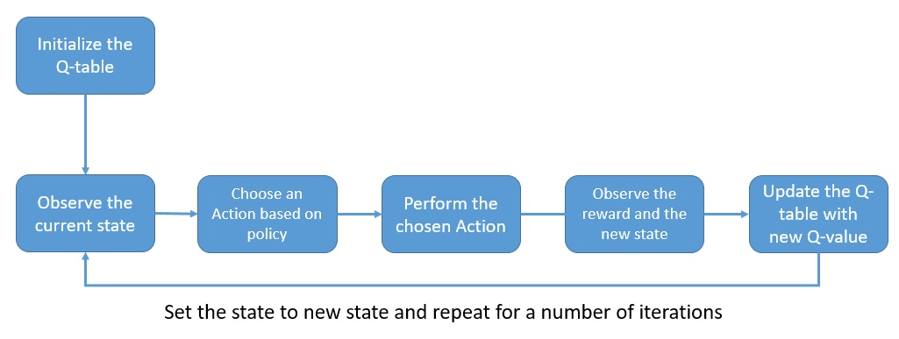
Q-Learning Process
The q-values are stored and updated in a q-table
dimensions matching the number of actions and states in the environment

Slide 37
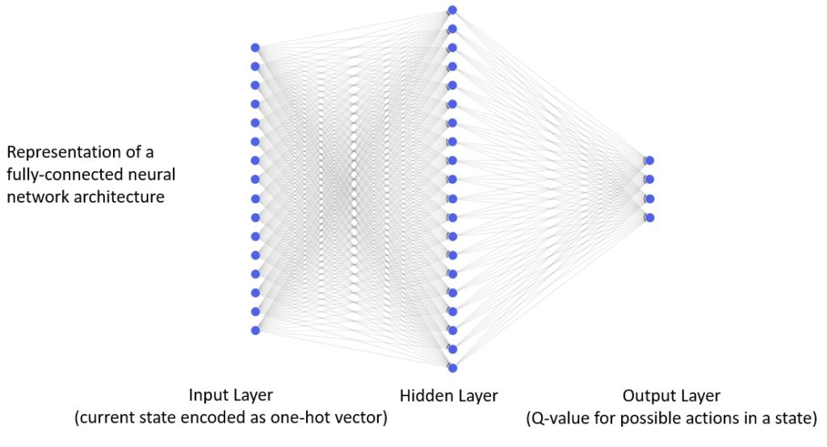
Reinforcement Learning with Neural Networks
The number of actions and states in a real-life environment can be thousands, making it extremely inefficient to manage q-values in a table
can use neural networks to predict q-values for actions in a given state instead of using a table.
ReLU as the activation function in the hidden layer
Linear activation function in the output layer

Slide 38
Reinforcement Learning with Neural Networks
The Loss Function and Optimizer
The mean-squared-error loss function measures the square value of the difference between the prediction and the target:
take the feedback backward through the network and update the weights
Simplest Solution is Backpropagation with the classical stochastic gradient descent

Slide 39
Reinforcement Learning with Neural Networks
Code Blocks:
// Parameters
discount_factor = 0.95
eps = 0.5
eps_decay_factor = 0.999
num_episodes=500
//Neural Network
model = Sequential()
model.add(InputLayer(batch_input_shape=(1, env.observation_space.n)))
model.add(Dense(20, activation='relu'))
model.add(Dense(env.action_space.n, activation='linear'))
model.compile(loss='mse', optimizer='adam', metrics=['mae’])

Slide 40
Reinforcement Learning with Neural Networks
for i in range(num_episodes):
state = env.reset()
eps *= eps_decay_factor
done = False
while not done:
if np.random.random() < eps: action = np.random.randint(0, env.action_space.n)
else:
action = np.argmax(model.predict(np.identity(env.observation_space.n)[state:state + 1]))
new_state, reward, done, _ = env.step(action)
target = reward + discount_factor *
np.max(model.predict(np.identity(env.observation_space.n)[new_state:new_state + 1]))
target_vector = model.predict(np.identity(env.observation_space.n)[state:state + 1])[0]
target_vector[action] = target
model.fit(np.identity(env.observation_space.n)[state:state + 1],
target_vec.reshape(-1, env.action_space.n), epochs=1, verbose=0)
state = new_state
one-hot encoded current state, and the target value converted as a vector to train the model on a single step

Slide 41
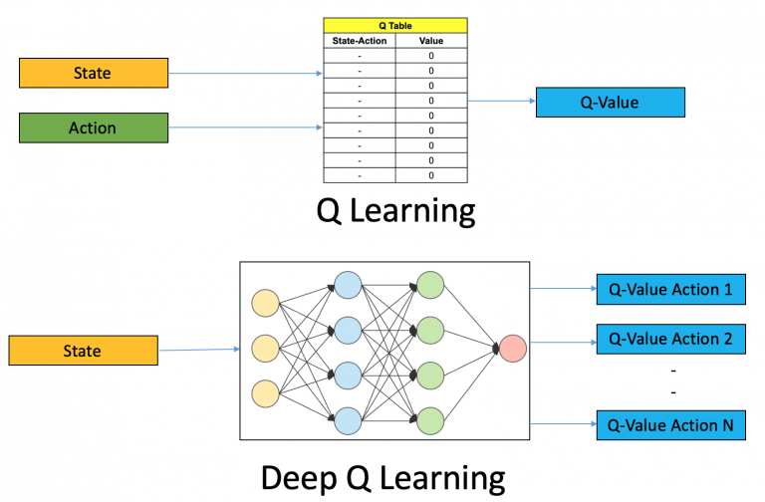
Deep Q Learning
approximate these Q-values with machine learning models such as a neural network
idea behind DeepMind’s algorithm that led to its acquisition by Google for 500 million dollars!

Slide 42
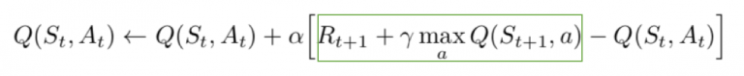
Steps in Deep Q Networks
All the past experience is stored by the user in memory
The next action is determined by the maximum output of the Q-network
The loss function here is mean squared error of the predicted Q-value and the target
Q-value – Q*
As per the Q-value update equation derived from the Bellman equation:
green represents the target
Since R is the unbiased true reward, the network is going to update its gradient using backpropagation to finally converge

Slide 43
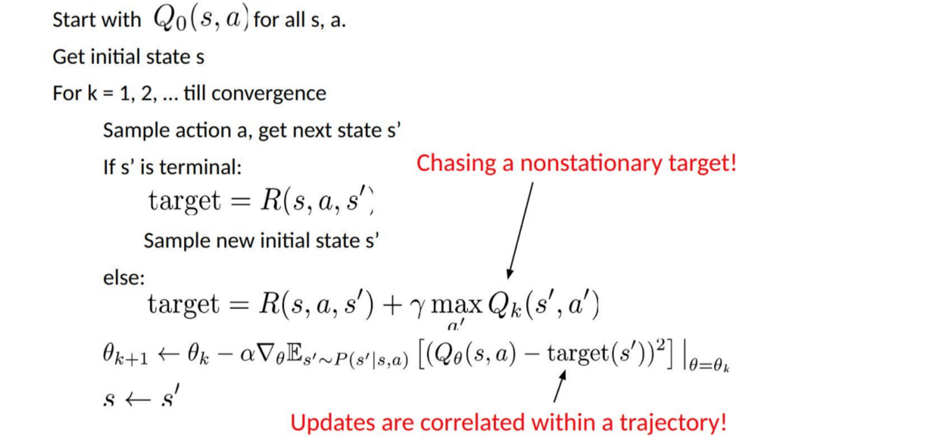
Psuedocode for Deep Q-Learning

Slide 44
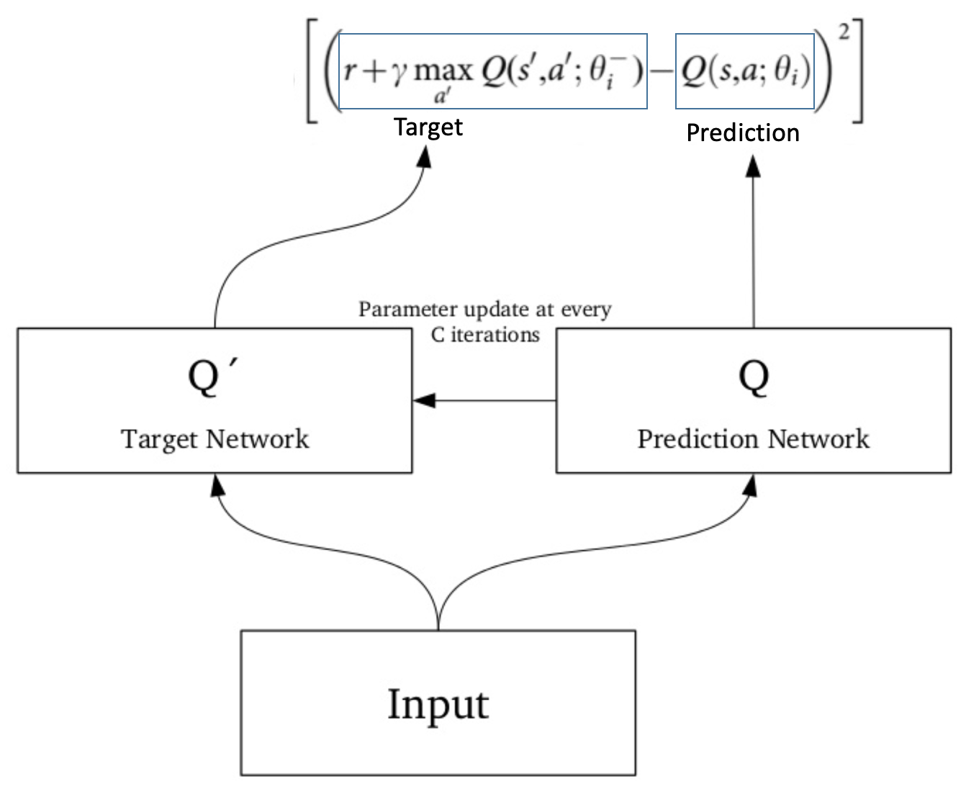
Solution in deep Q-network (DQN)
Separate network to estimate the target
Target network has the same architecture as the function approximator but with frozen parameters
For every C iterations (a hyperparameter), the parameters from the prediction network are copied to the target network.
This leads to more stable training because it keeps the target function fixed (for a while):
Experience Replay
Instead of running Q-learning on state/action pairs as they occur during simulation or the actual experience
the system stores the data discovered for [state, action, reward, next_state] – in a large table.

Slide 45
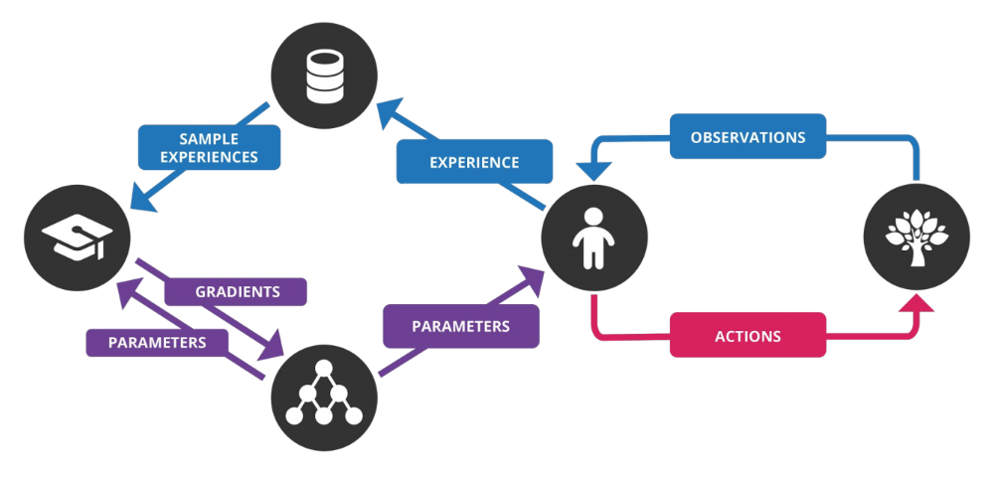
deep Q-network (DQN)

Slide 46
steps involved in deep Q-network (DQN) :
Preprocess and feed the game screen (state s) to DQN, which will return the Q-values of all possible actions in the state
Select an action using the ε-greedy policy.
Perform this action in a state s and move to a new state s’ to receive a reward.
This state s’ is the preprocessed image of the next game screen. We store this transition in our replay buffer as <s,a,r,s’>
Next, sample some random batches of transitions from the replay buffer and calculate the loss- (squared difference between target Q and predicted Q)
Perform gradient descent with respect to our actual network parameters in order to minimize this loss
After every C iterations, copy our actual network weights to the target network weights
Repeat these steps for M number of episodes

Slide 47
Cartpole & DQN
model = Sequential()
model.add(Flatten(input_shape=(1,) + env.observation_space.shape))
model.add(Dense(16))
model.add(Activation('relu'))
model.add(Dense(nb_actions))
model.add(Activation('linear'))
print(model.summary())

Slide 48
Cartpole & DQN
policy = EpsGreedyQPolicy()
memory = SequentialMemory(limit=50000, window_length=1)
dqn = DQNAgent(model=model, nb_actions=nb_actions, memory=memory, nb_steps_warmup=10,
target_model_update=1e-2, policy=policy)
dqn.compile(Adam(lr=1e-3), metrics=['mae'])
dqn.fit(env, nb_steps=5000, visualize=True, verbose=2)

Slide 49
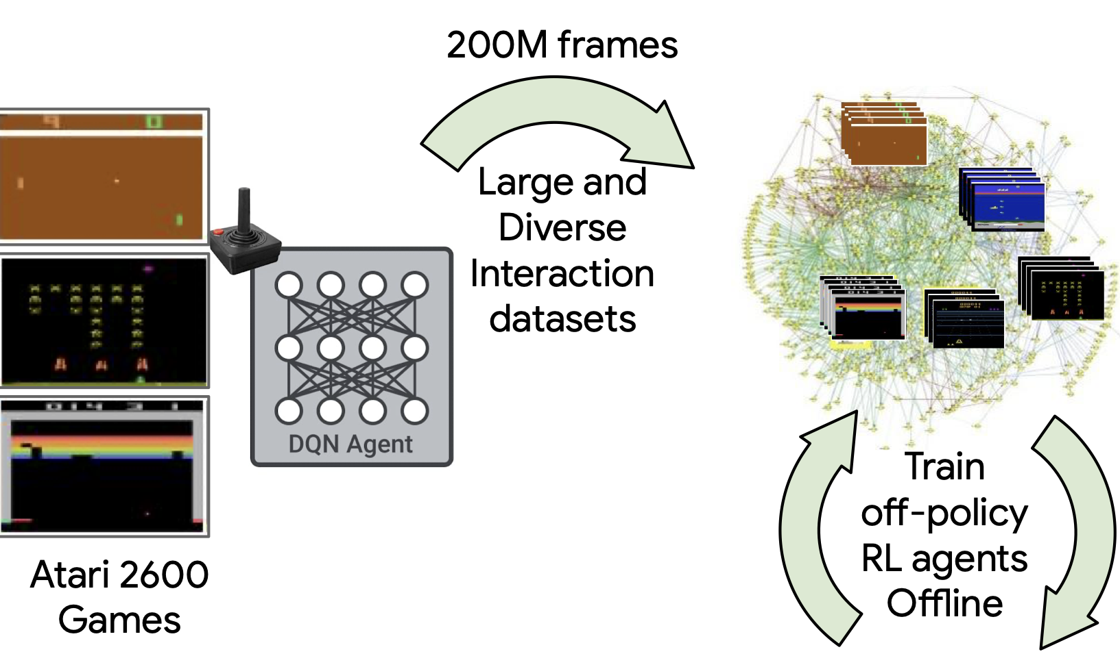
Discretizing Continuous State Space
In case of Video- Frames are input & CNN is used in the DQN
Cartpole - 5-state discretization of the state space
S = { hard_lean_left,
soft_lean_left,
soft_lean_right,
hard_lean_right,
fallen
}

Slide 50
Discretizing Continuous State Space
Rewards
fallen => -1
soft_lean_left => +1
soft_lean_right => +1
hard_lean_left => 0
hard_lean_right => 0
Actions the agent could invoke on the cart in order to balance the pole:
A = { push_left,
push_right
}

Slide 51
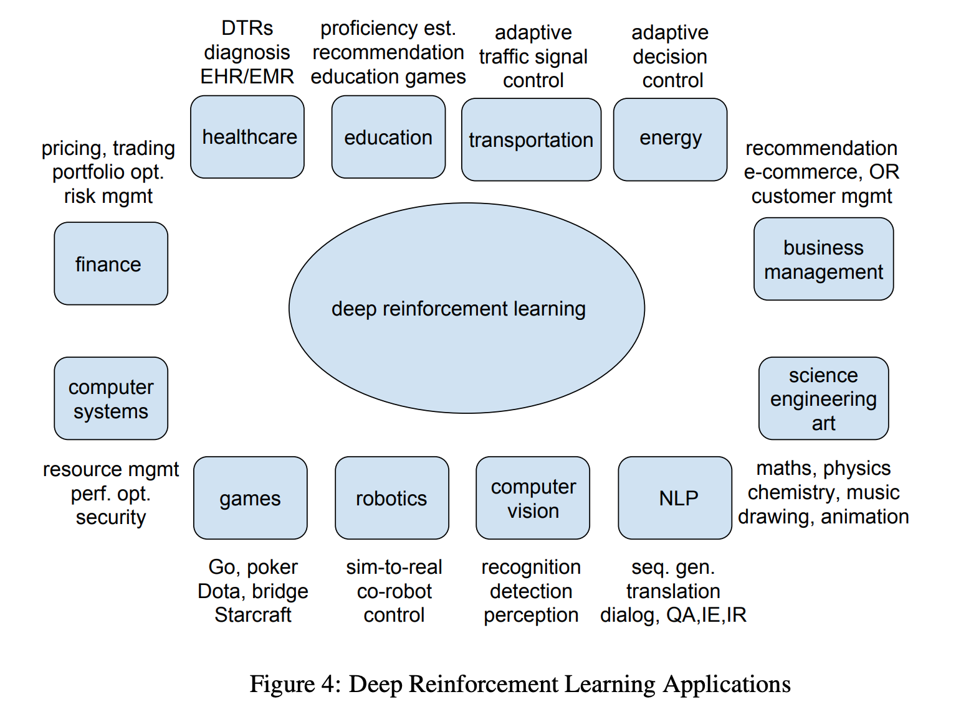
Industry Ready Applications
Google’s Cloud AutoML
Facebook’s Horizon Platform

Slide 52
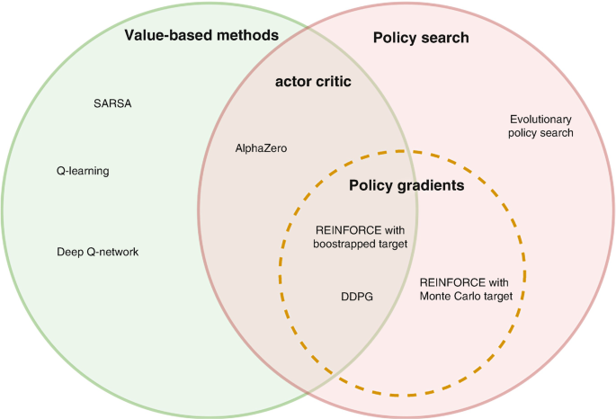
Policy vs Value based Reinforcement Learning
Policy learning focuses on directly inferring a policy that maximizes the reward on a specific environment
Value learning tries to quantify the value of every state-action pair
Example: AI agent trying to learn a new chess opening
Using policy reinforcement learning, the AI agent would try to infer a strategy to develop the pieces in a way that can achieve certain well-known position
In Value-learning, the AI agent would assign a value to every position and select the moves that score higher.

Slide 53
Deterministic Vs Stochastic Policy
Policy is a set of rules that is referenced whenever we want to know what action to take
Deterministic policy
offer a state-action mapping π:s ↦ a
Ideally the optimal mapping (that is, if all the Bellman equations are learned to perfection)
Stochastic policy
conditional probability distribution over the actions in a given state, π:P(a|s)
Advantages of Stochastic Policy: Use in
Continuous Action Spaces
Stochastic Environments
Multi-agent environments
Partially Observable MDPs
For example : In game of rock-paper-scissors use stochastic policy

Slide 54
REINFORCE
Key idea
reinforcing good actions: to push up the probabilities of actions that lead to higher return
and push down the probabilities of actions that lead to a lower return
until we get the optimal policy.
The policy gradient method will iteratively amend the policy network weights
(with smooth updates)
to make state-action pairs that resulted in positive return more likely
and make state-action pairs that resulted in negative return less likely
Trajectory
Return for a Trajectory
Total Return or Future Return

Slide 55
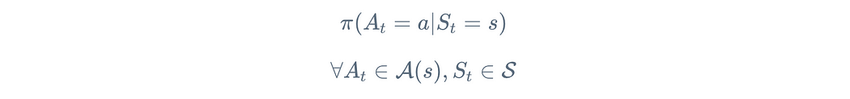
REINFORCE
Policy: A policy is defined as the probability distribution of actions given a state
The objective of a Reinforcement Learning agent is to maximize the “expected” reward when following a policy π.
Define a set of parameters θ to parametrize this policy
Parameters can be the coefficients of a complex polynomial or the weights and biases of units in a neural network
If we represent the total reward for a given trajectory τ as r(τ), we arrive at :
Reinforcement Learning Objective: Maximize the “expected” reward following a parametrized policy

Slide 56
REINFORCE
Notation ϴ is the policy’s parameter vector
Thus Π(a|s, ϴ) = Pr{A_{t}=a | S_{t}=s, ϴ_{t}=ϴ} for the probability that action a is taken at time t given that the environment is in state s at time t with parameter ϴ
learning the policy parameter based on the gradient of some scalar performance measure J(ϴ) with respect to the policy parameter
These methods seek to maximize performance, so their updates approximate gradient ascent in J:
is a stochastic estimate whose expectation approximates the gradient
of the performance measure with respect to its argument ϴ_{t}

Slide 57
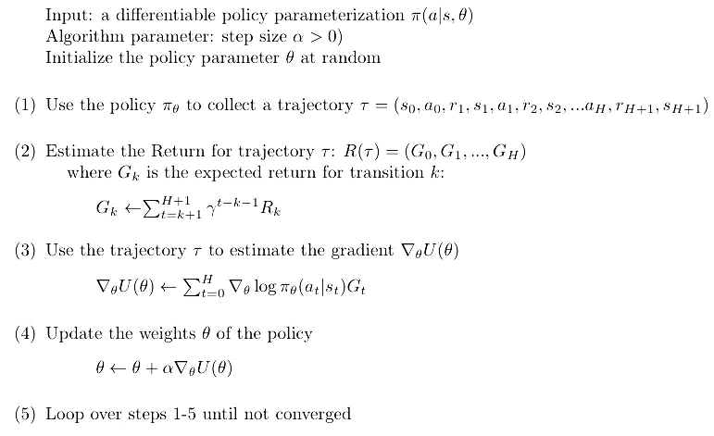
REINFORCE (Monte Carlo Policy Gradients)
Sometimes probabilities may be extremely tiny or very close to 1
instead use a surrogate objective, log p (natural logarithm)
since the log of probability space ranges from (-∞,0)
and this makes the log probability easier to compute.

Slide 58
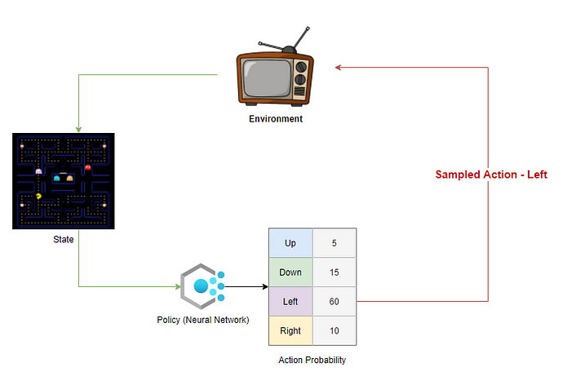
Example
The policy is usually a Neural Network that takes the state as input and generates a probability distribution across action space as output

Slide 59
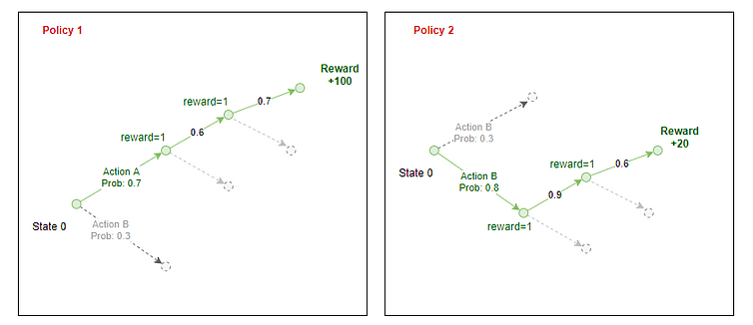
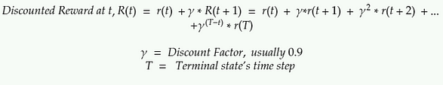
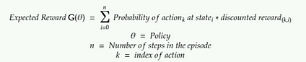
Example: Policy 1 vs Policy 2 Trajectories
A

Slide 60
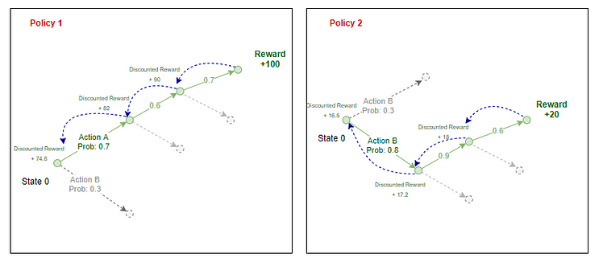
The steps in the implementation of REINFORCE
Initialize a Random Policy (a NN that takes the state as input and returns the probability of actions)
Use the policy to play N steps of the game — record action probabilities-from policy, reward-from environment, action — sampled by agent
Calculate the discounted reward for each step
Calculate expected reward G
Adjust weights of Policy (back-propagate error in NN) to increase G
Repeat from 2
A

Slide 61
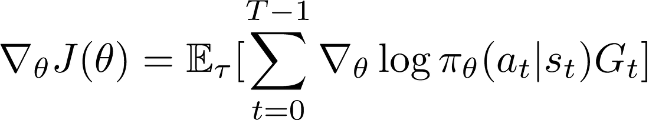
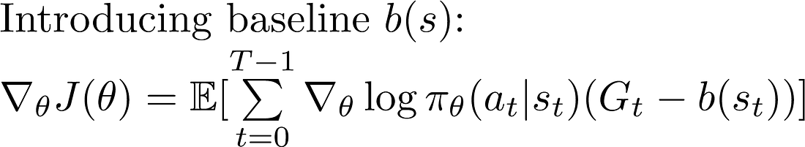
Disadvantages of REINFORCE
The Policy Gradient is :
Has high variability in log probabilities and cumulative reward values, because each trajectories during training can deviate from each other at great degrees
Can result in noisy gradients, and cause unstable learning and/or the policy distribution skewing to a non-optimal direction
Can have cumulative reward of 0- both “goods” and “bad” actions with will not be learned if the cumulative reward is 0
will make smaller gradients, and thus smaller and more stable updates.

Slide 62
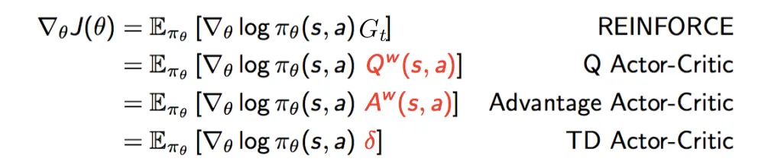
Common Baseline Functions

Slide 63
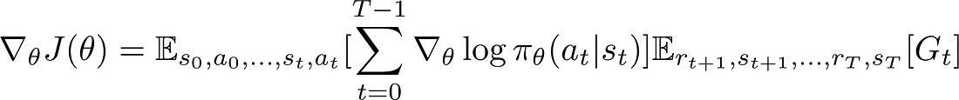
Actor Critic Methods
Policy gradient in REINFORCE

Slide 64
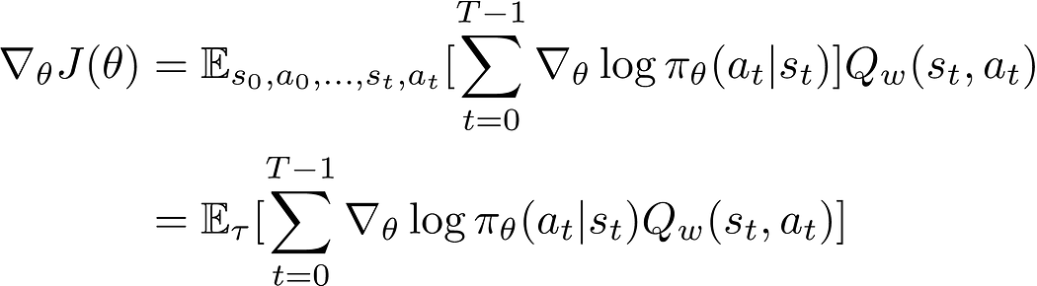
Actor Critic Methods
Q value can be learned by parameterizing the Q function with a neural network

Slide 65
General Learning Agent
Learning element which is responsible for making improvements
Performance element, which is responsible for
selecting external actions
Critic tells the learning element how well the agent is doing with respect to a fixed performance standard
Problem Generator which is responsible for suggesting actions that will lead to new and informative experiences.

Slide 66
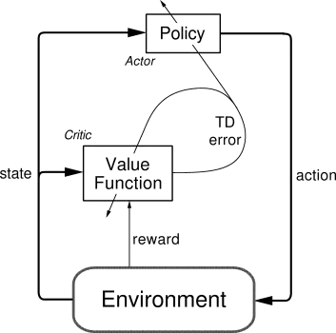
Actor Critic Methods
The “Critic” estimates the value function
This could be the action-value (the Q value) or state-value (the V value).
The “Actor” updates the policy distribution
in the direction suggested by the Critic (such as with policy gradients).
Both the Critic and Actor functions are parameterized with neural networks

Slide 67
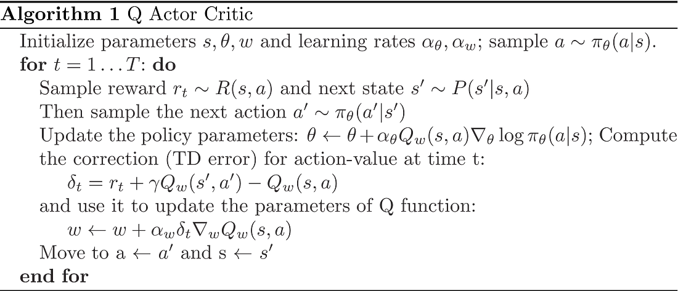

Slide 68
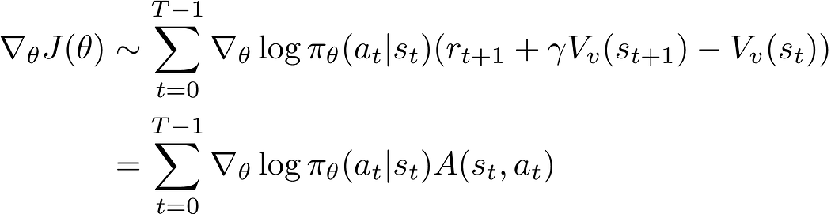
Advantage Actor Critic (A2C)
Advantage Value- Take a specific action compared to the average, general action at the given state
Using Bellman Equation:

Slide 69
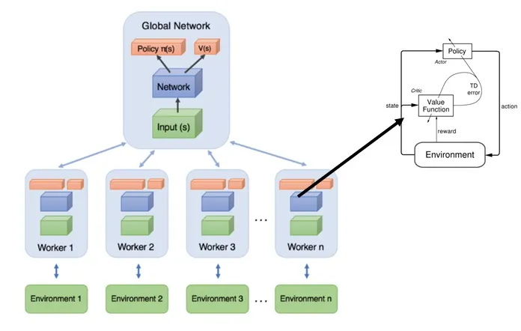
Asynchronous Advantage Actor Critic (A3C)
implements parallel training where multiple workers in parallel environments independently update a global value function
Key benefit of having asynchronous actors is effective and efficient exploration of the state space.

Slide 70
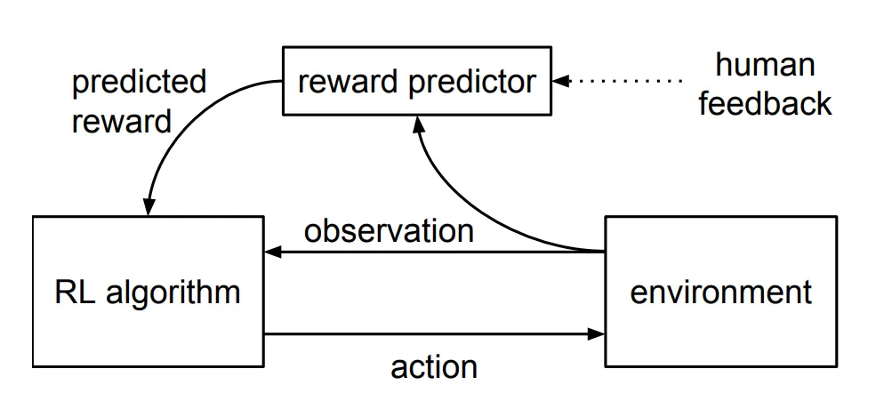
ChatGPT- Reinforcement Learning from Human Feedback
The method overall consists of three distinct steps:
Supervised fine-tuning
A pre-trained language model is fine-tuned on a relatively small amount of demonstration data curated by labelers, to learn a supervised policy (the SFT model) that generates outputs from a selected list of prompts
This represents the baseline model.
Mimic human preferences
Labelers are asked to vote on a relatively large number of the SFT model outputs, creating a new dataset consisting of comparison data.
A new model is trained on this dataset
This is referred to as the reward model (RM).
Proximal Policy Optimization (PPO)
The reward model is used to further fine-tune and improve the SFT model.
The outcome of this step is the so-called policy model.

Slide 71
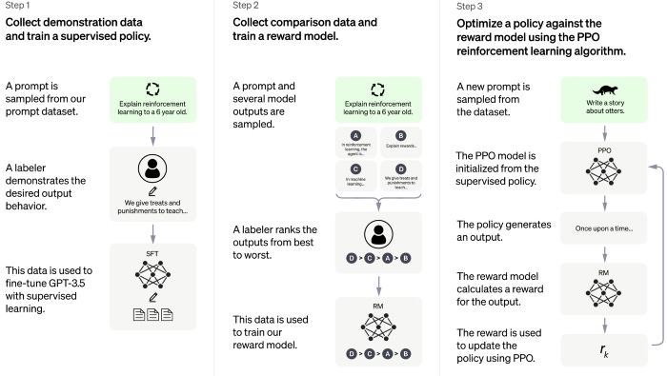
How ChatGPT works
Proximal Policy Optimization (PPO) algorithms are policy gradient methods

Slide 72
References
1. Russell S., and Norvig P., Artificial Intelligence A Modern Approach (3e), Pearson 2010
2. Richard S Sutton, Andrew G Barto, Reinforcement Learning, second edition, MIT Press
3. https://www.coursera.org/learn/fundamentals-of-reinforcement-learning/home/week/1

